Slide 1

PE 1 4.6 B Dictionaries
Programming Logic

Slide 2

What are Dictionaries?
A dictionary in Python is a collection of items.
Each item is a pair made of a key and a value.
Dictionaries are used to store data values like a map, which unlike other Data Types that hold only a single value as an element, Dictionary holds key:value pair..

Slide 3
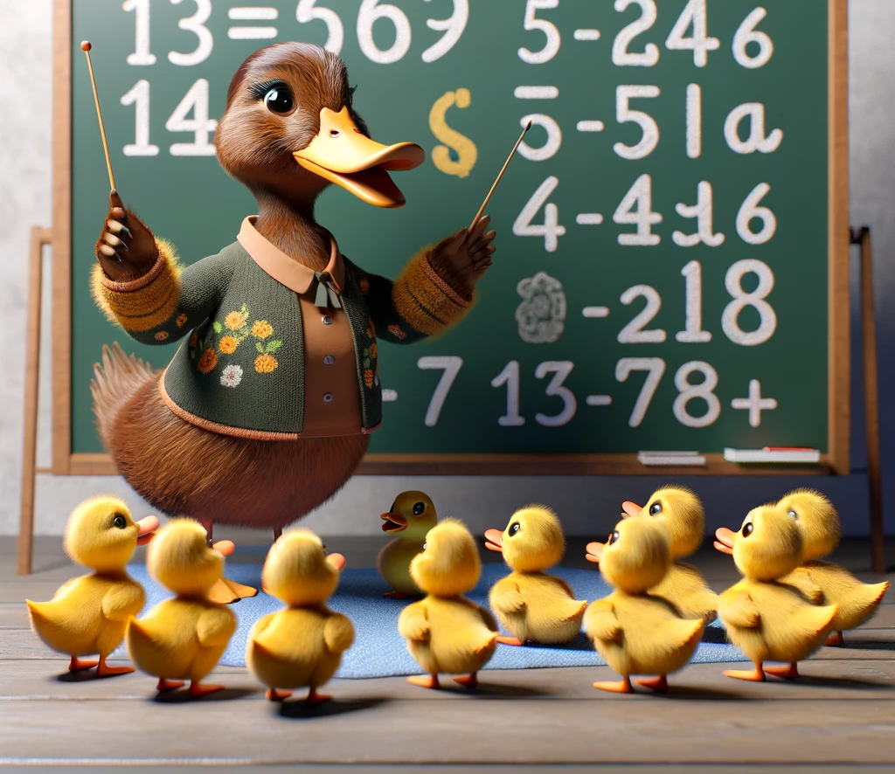
Sample
english_to_spanish = {
"one": "uno",
"two": "dos",
"three": "tres",
"four": "cuatro",
"five": "cinco",
"six": "seis",
"seven": "siete",
"eight": "ocho",
"nine": "nueve",
"ten": "diez"
}

Slide 4
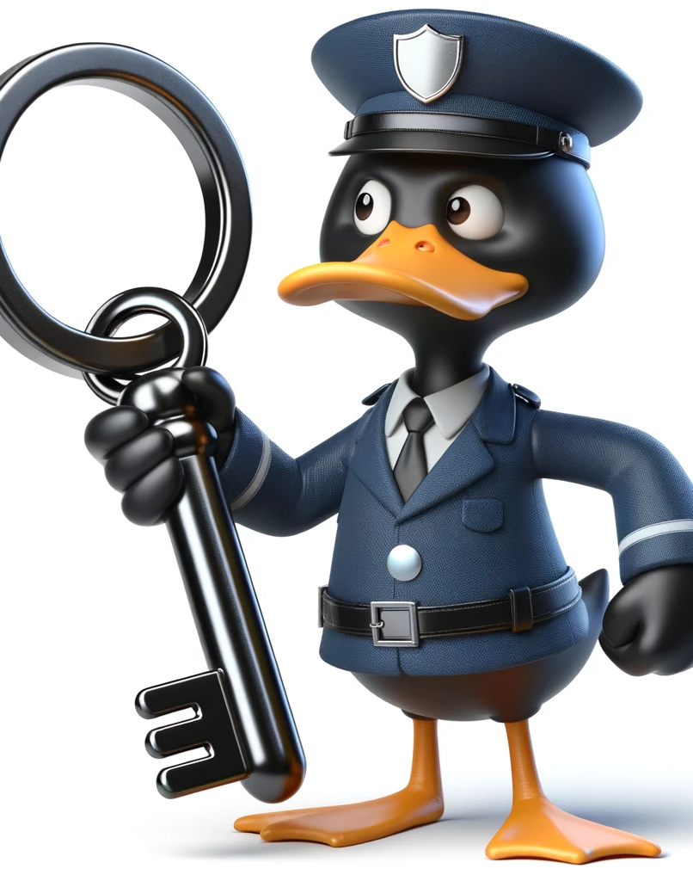
Using Keys
To access a specific value, use the key enclosed in square brackets.
my_dict = {'name': 'John', 'age': 30}
value = my_dict['name'] # Access 'John'

Slide 5

Get()
Safely access values using the get() method to avoid KeyError.
my_dict = {'name': 'John', 'age': 30}
value = my_dict.get('country', 'USA') # Access 'USA' as default if 'country' doesn't exist

Slide 6

Looping
Iterating through Keys: Use a loop to access all keys and their corresponding values.
my_dict = {'name': 'John', 'age': 30}
for key in my_dict:
print(key, my_dict[key]) # Access both key and value

Slide 7

Items()
Using Items: Iterate through key-value pairs using the items() method.
my_dict = {'name': 'John', 'age': 30}
for key, value in my_dict.items():
print(key, value) # Access both key and value

